Slide 1

Exploratory analysis Location recommendations
Steven L Truong
Friday, 02/04/2021

Slide 2


Slide 3

INTRODUCTION
MOTIVATION:
Greenwood LLC wants to expand their business and open the authentic Vietnamese restaurant in NYC.
They want to leverage Data Science and Analytics skills set to optimize their chance of success.
OBJECTIVES:
Determine the top stations with the most traffic.
Conclude the best location based on the volume of traffic and surrounding venues.
GOALS:
Logically and analytically present the results.

Slide 4









methodology
Data source:
MTA Turnstile Data
Square API
Tools:
Numpy and Pandas
Matplotlib and Seaborn
Folium, wordcloud, requests

Slide 5
methodology
Exploration
Pull turnstile data from the source (MTA website)
Use Square API to pull data in json format into local machine for further analysis
Preparation
Clean raw data
Converse data from json to regular pandas dataframe
Visualization
Create graphs (time series, bar charts)
Generate NYC map with traffic density and venues wordclouds

Slide 6
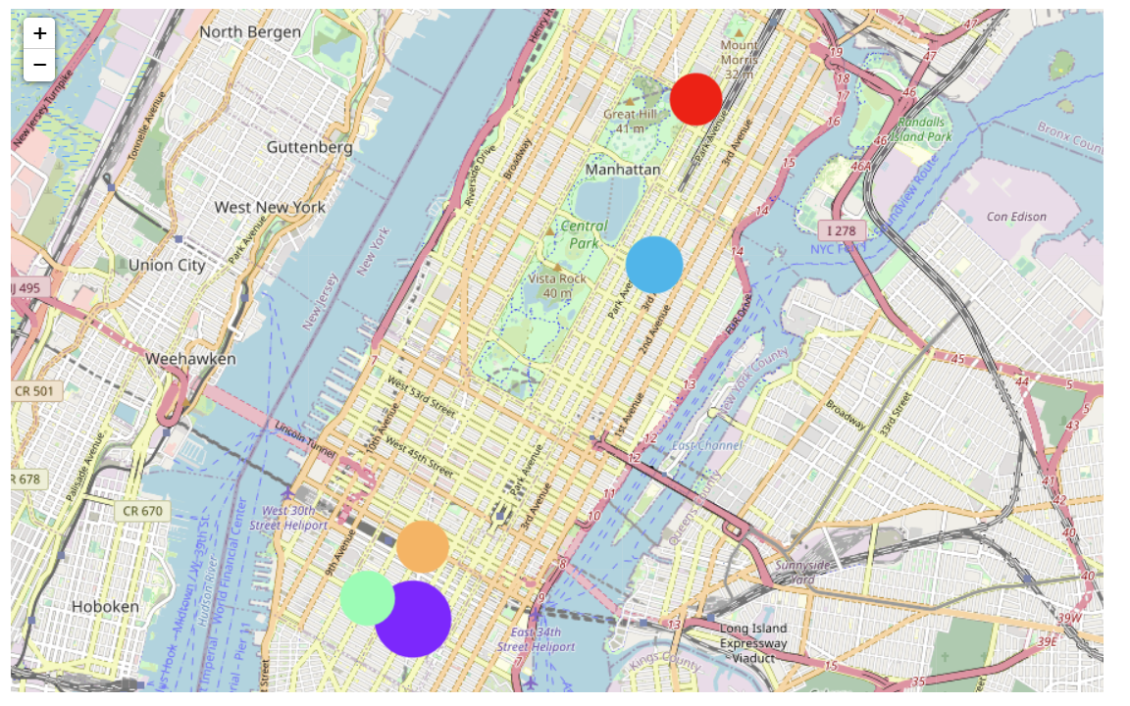
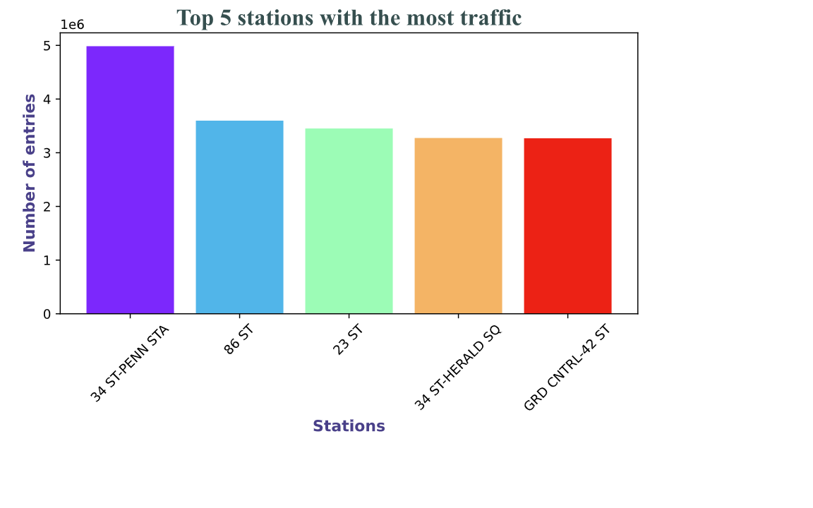
RESULTS
Top 5 stations with the most traffic:
34 St - Penn Station (near Korean town - Manhattan)
86 St Station (Upper East Side - Yorkville)
23 St Station (near Korean town - Manhattan)
34 St - Herald Square Station (near Korean town - Manhattan)
Grand Central - 42 St Station (near Korean town - Manhattan)

Slide 7
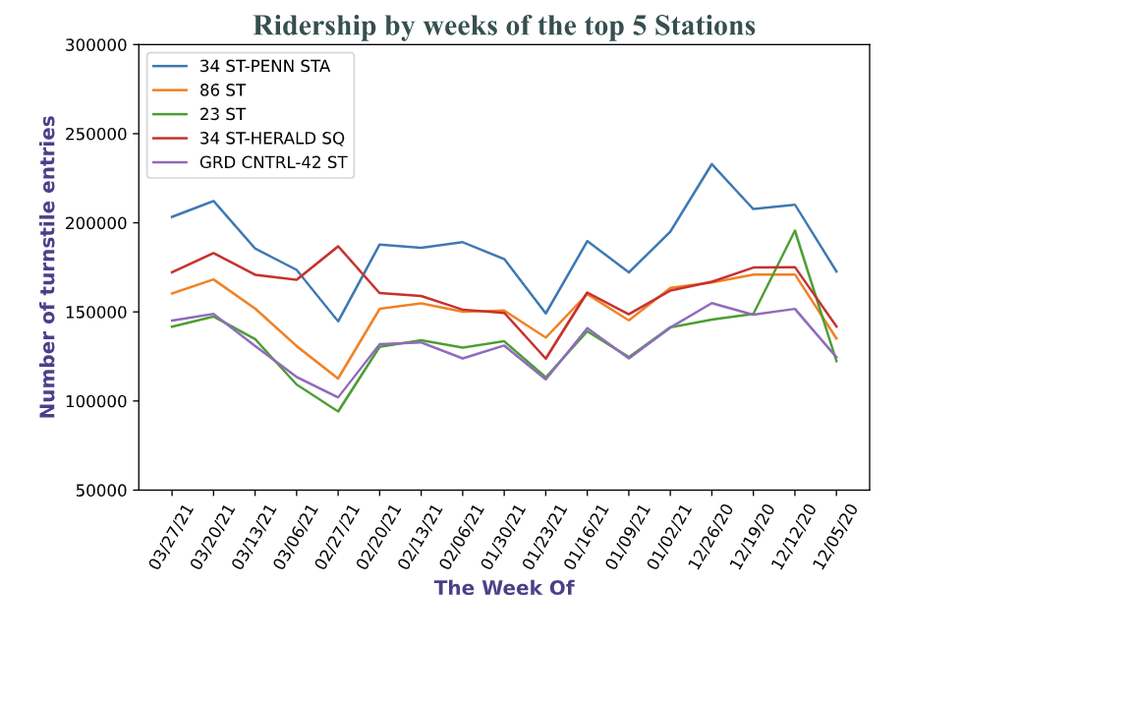
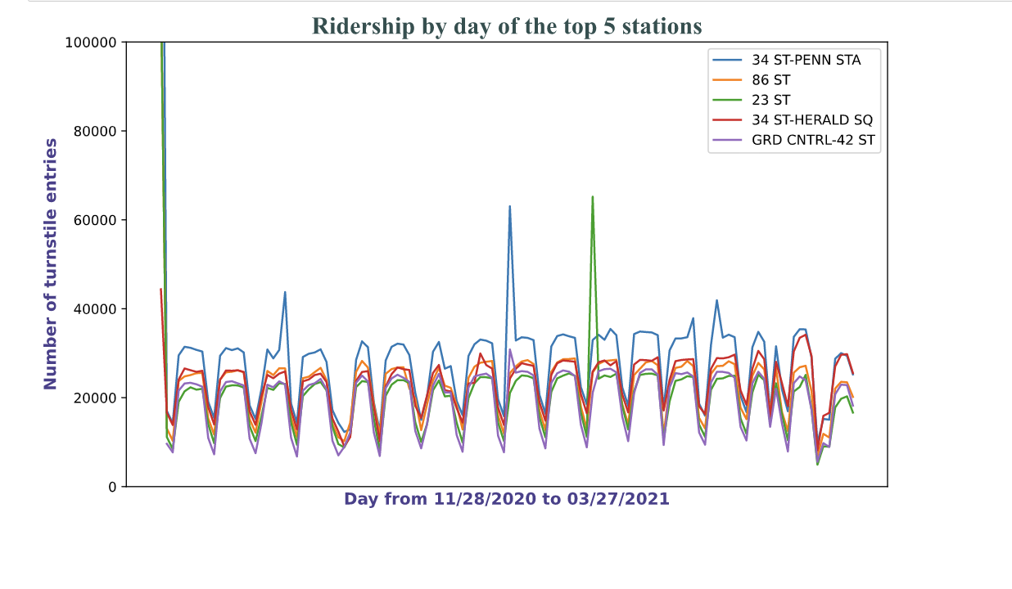
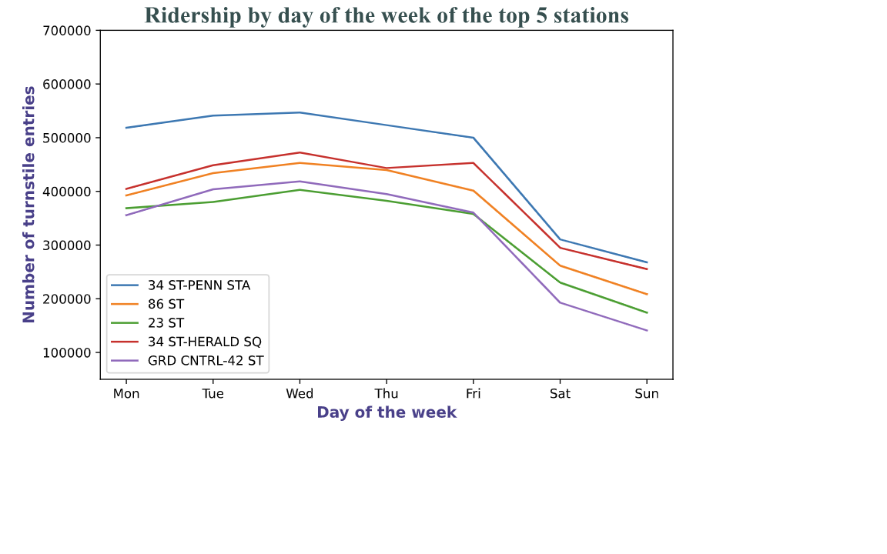
RESULTS
What about each neighborhood’s nearby venues? Are there already lots of Vietnamese restaurants? Does the demand still need the supply?

Slide 8
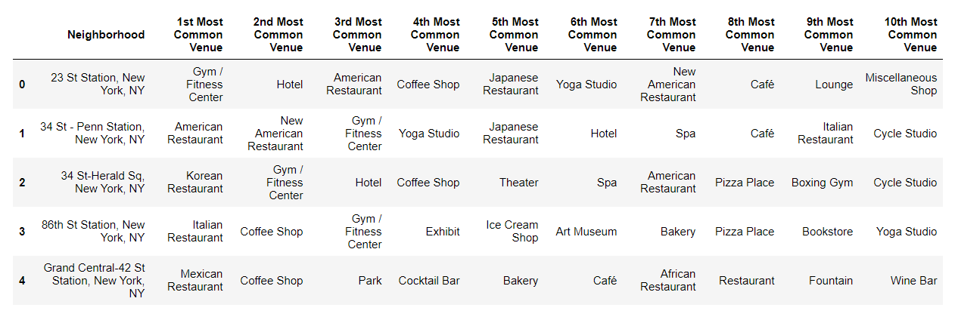
DISCUSSION
Top 10 most common venues around each neighborhood
Perhaps this is a bit hard to see, let’s visualize them!

Slide 9
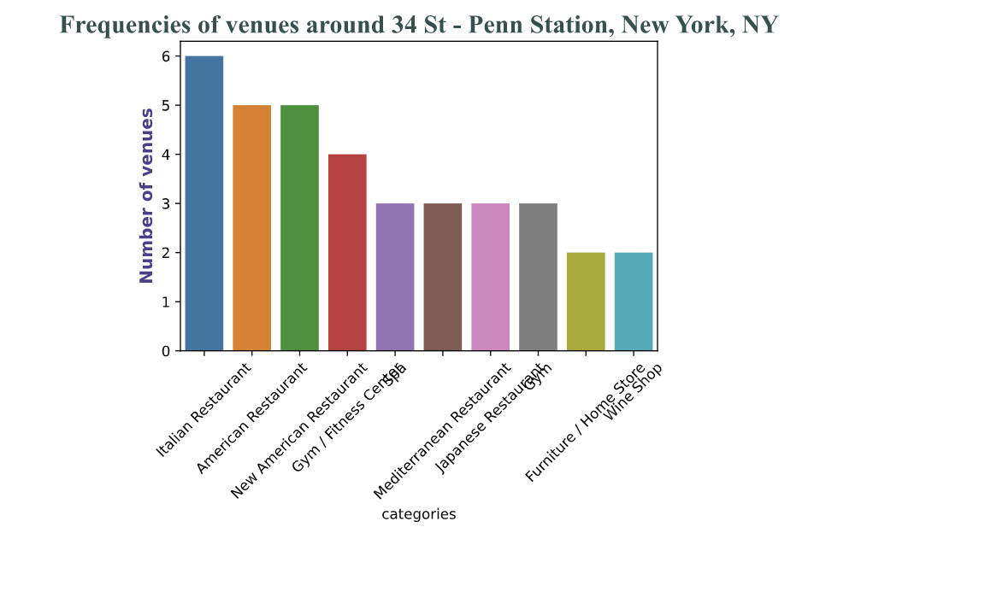
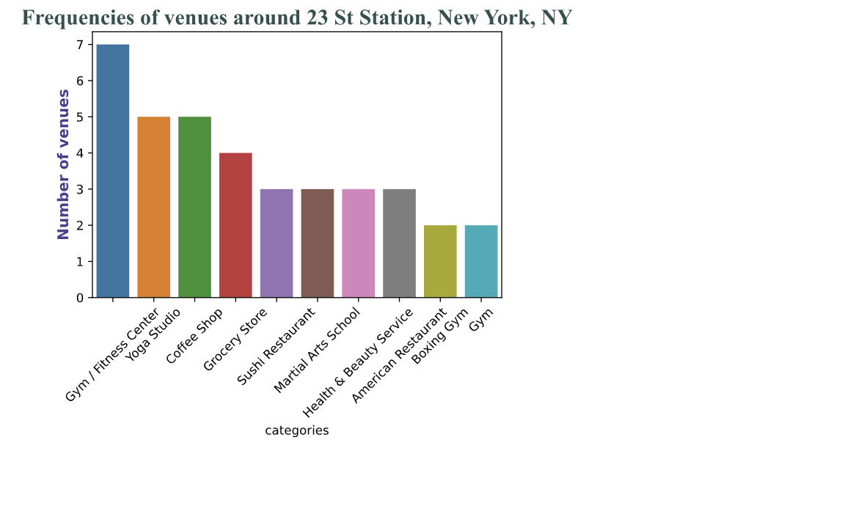
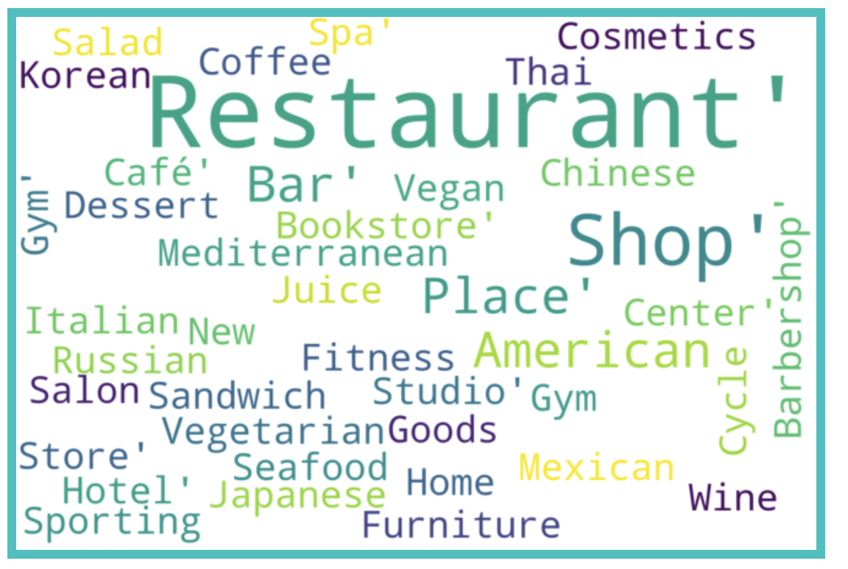
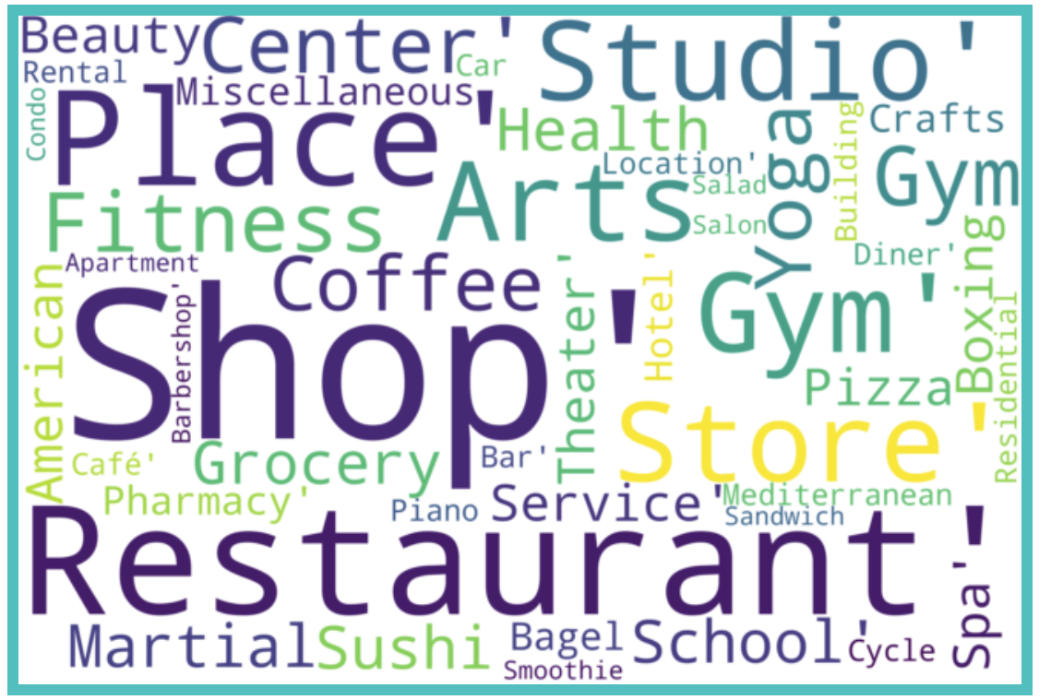
DISCUSSION
Nearby venues of 34 St – Penn station and 23 St station

Slide 10
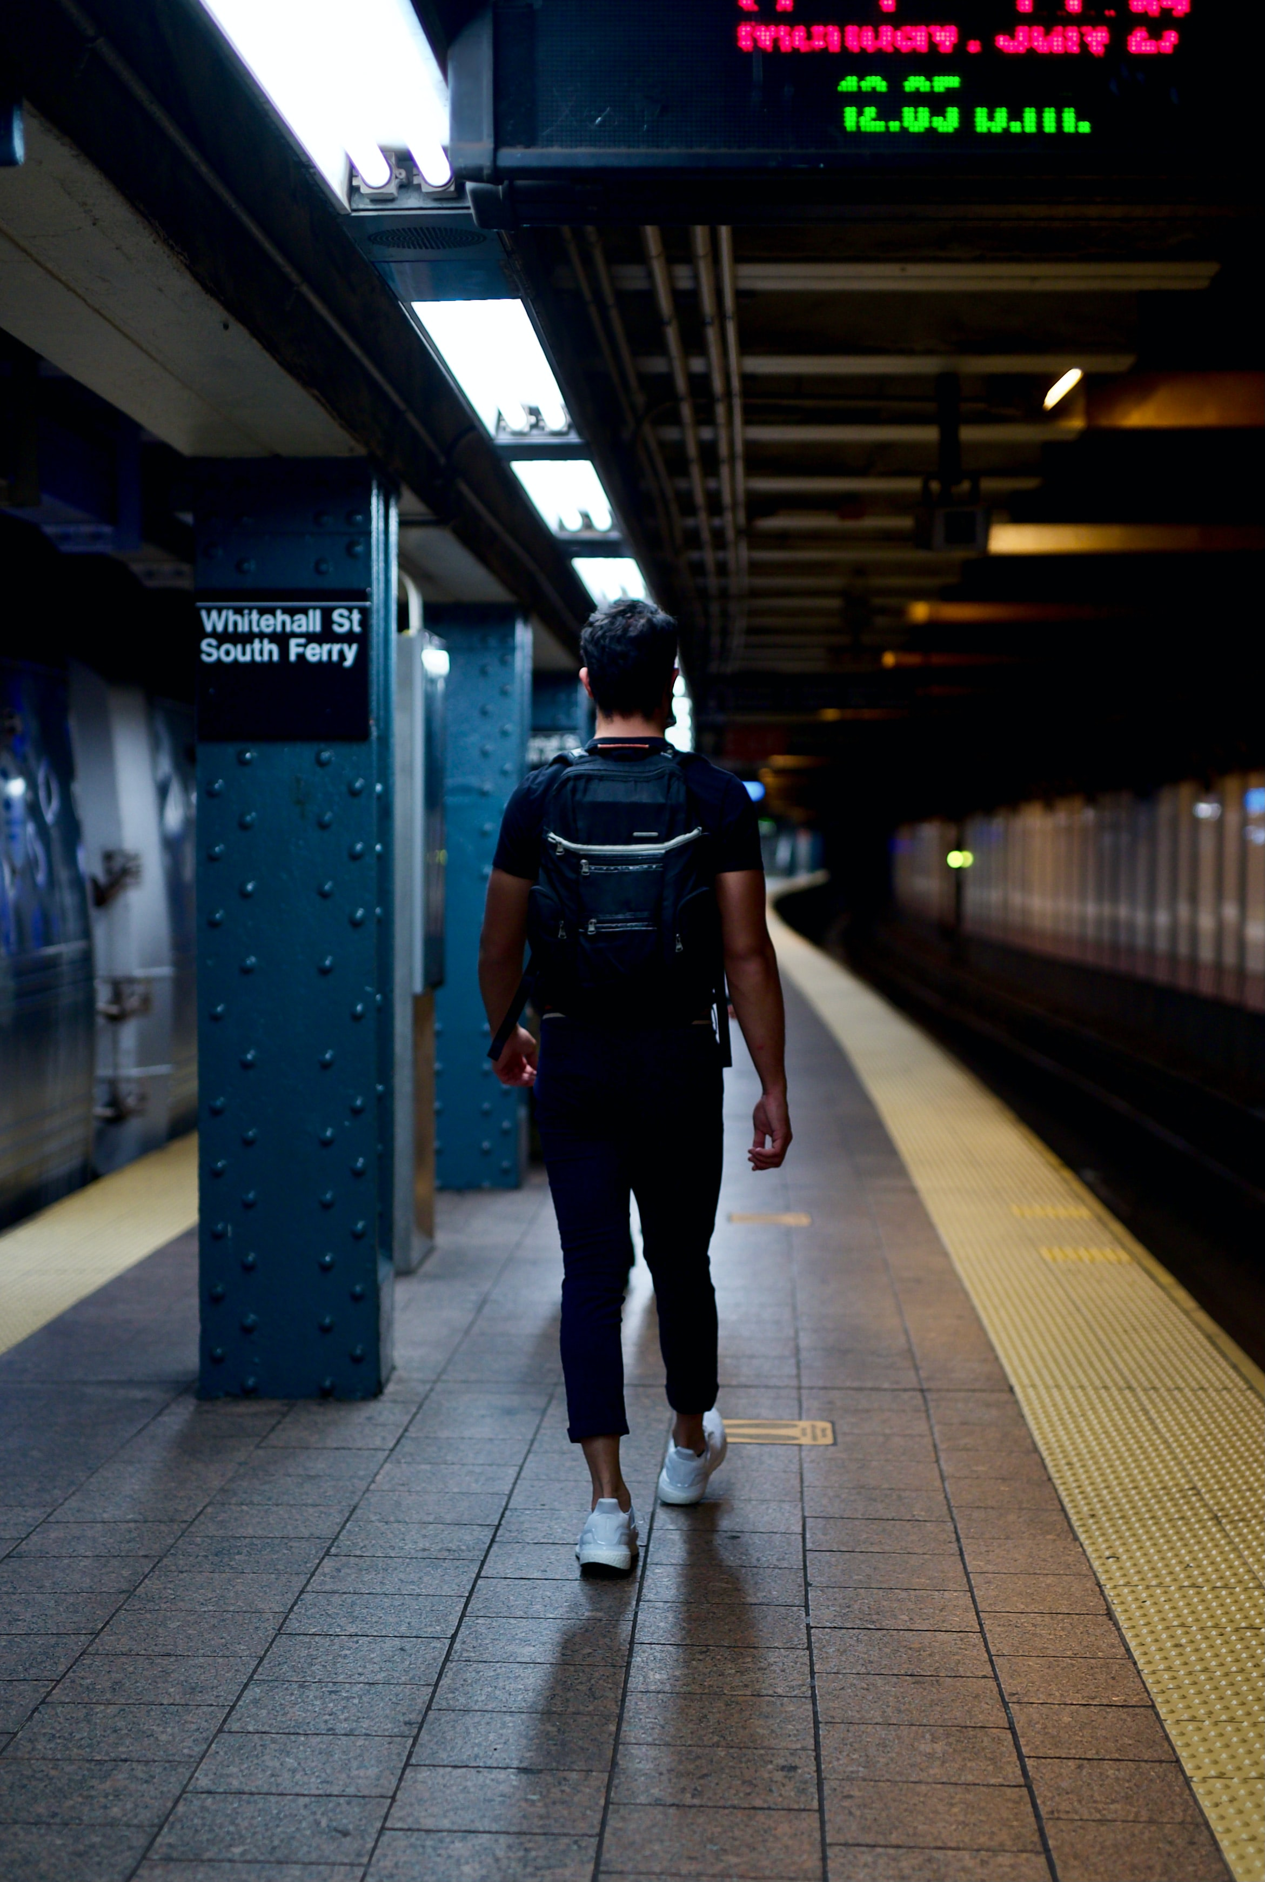
Conclusion
The 34 St – Penn Station and the 34 St – Herald Sq neighborhoods have many restaurants around them => not very suitable to open another one.
Recommendation: neighborhood around 23 st station.

Slide 11
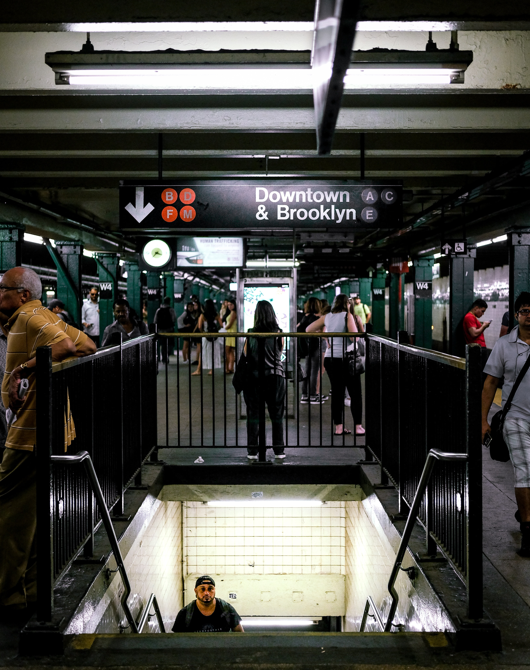
FUTURE WORK
Focus more on the neighborhood’s demographic.
Incorporate other data sources (such as crime rates or median income of certain population) to help shaping the results based on the business’ targeted customers.
Investigate customers’ behaviors to see whether they are affected by covid.

Slide 12
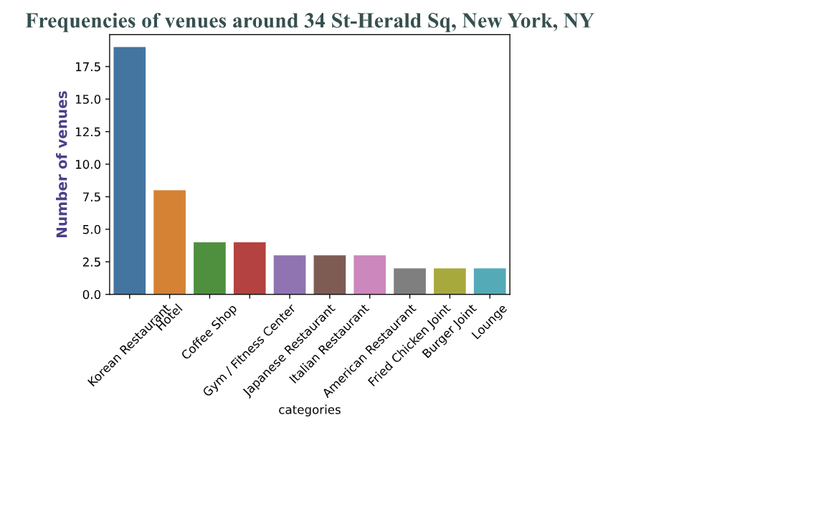
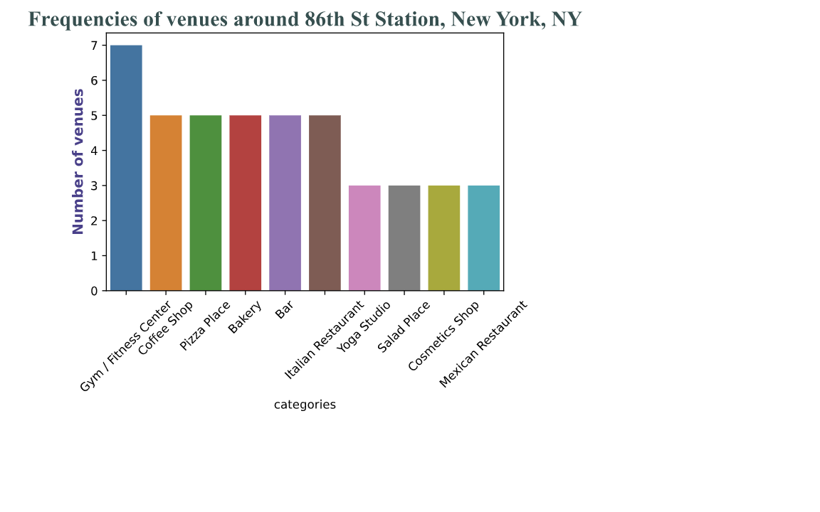
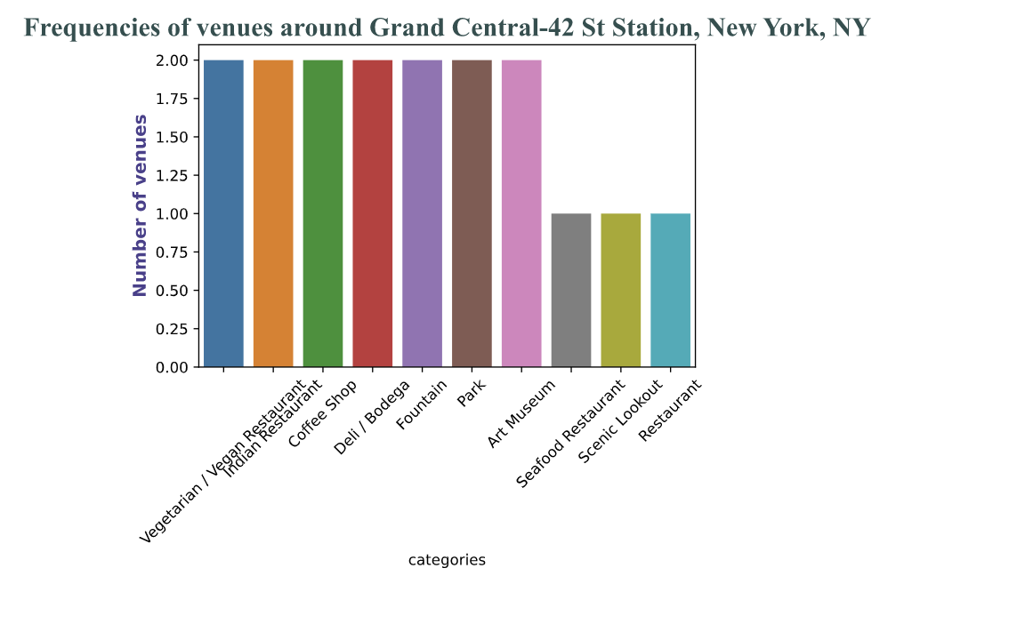
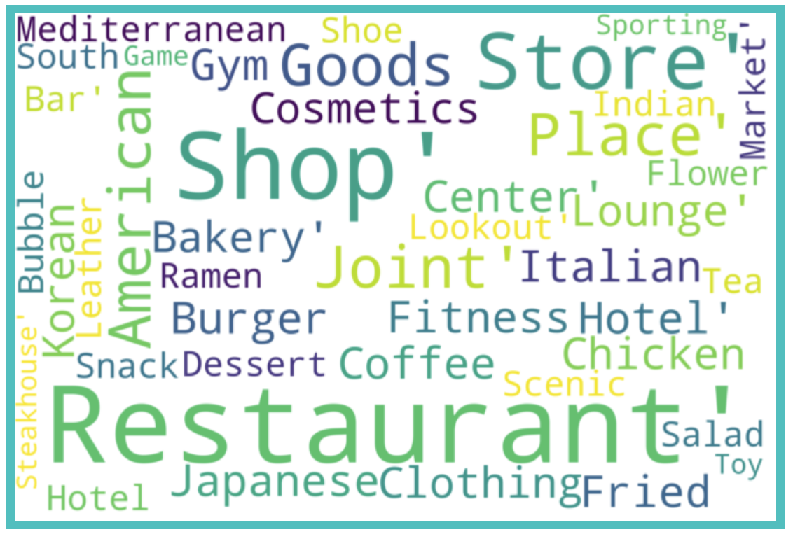
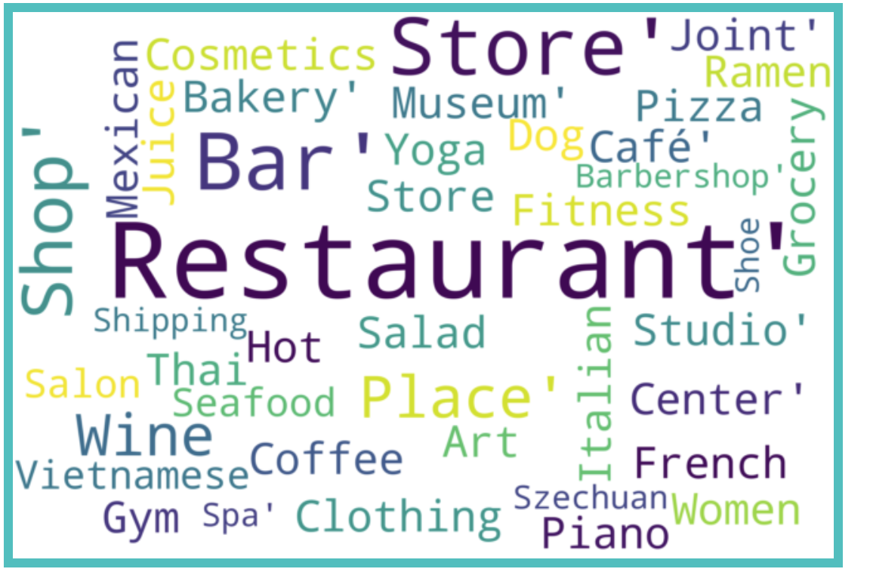
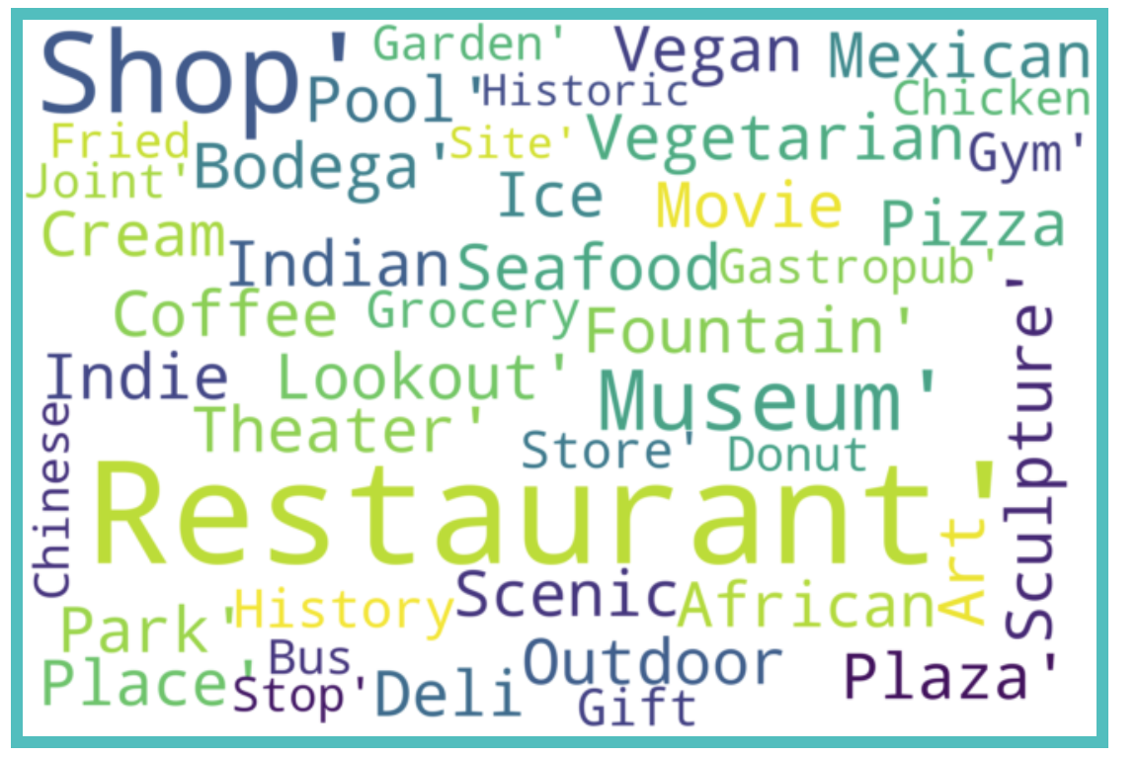
APPENDIX
Bar plots for the other 3 top stations along with their word clouds

Slide 13
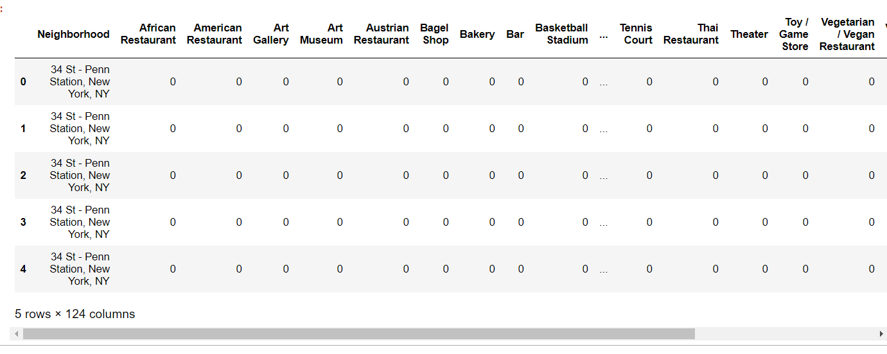
APPENDIX
First few rows of one hot encoding the neighborhood for each station
Documentation on how to use Square API to explore nearby venues given the neighborhood’s coordinates (latitude and longitude): https://developer.foursquare.com/docs/api-reference/venues/explore/

Slide 14



THANK YOU
Questions?
STEVEN L TRUONG
https://github.com/luongtruong77
tqluong77@gmail.com

